Slide 1
Python! Day 3
Introduce the True False (Boolean values)
Create a few examples of true and false with conditionals (ie. A > 30)
Explain what Booleans are and where they are used in software and real life (doors, led lights, etc.)
Basic If Else example
If Elif
If Elif with numerical comparison
Many If elif statements
Small If elif project
And / or keywords

Slide 2
Warm up
Write a program that asks a user how old they are and then prints how old they will be in 5 years
Ex: If the user is 15 years old, then the program should print
“In 5 years, you will be 20 years old”
Hint: use the input(), print(), int(), and str() functions

Slide 3
Boolean Review
Last class we learned about how to use int, string, and float variables but we didn’t use Boolean variables very much
Booleans are something that is either true or false
Ex: itsTuesday = true
This makes sense because it is true that today is Tuesday
Ex: itsWednesday = false
This makes sense because today is not Wednesday
This is useful if we want a program to do something only if something is true
For example: If itsRaining = true, that means it is raining so maybe the program could tell the user to bring an umbrella

Slide 4
We can create Boolean variables by directly making them equal to either true or false
Ex: is_raining = True or is_Wednesday = False
Try writing:
is_Tuesday = True
print(is_Tuesday)
We can also create Boolean variables by comparing 2 things
Ex: 4 > 1 is True and 279 < 18 is False
In Python we can do this by saying true_or_false = 3 < 8
Try writing:
math_comparison = 5 > 9
print(math_comparison)

Slide 5


Comparison Operators
Equal to: ==
Ex: 4 == 4
Greater than: >
Ex: 5 > 4
Less than: <
Ex: 3 < 4
Greater than or equal to: >=
Ex: 5 >= 4 or 4 >= 4
Less than or equal to: <=
Ex: 3 <= 4 or 4 <= 4
Not equal to: !=
Ex: 4 != 9

Slide 6
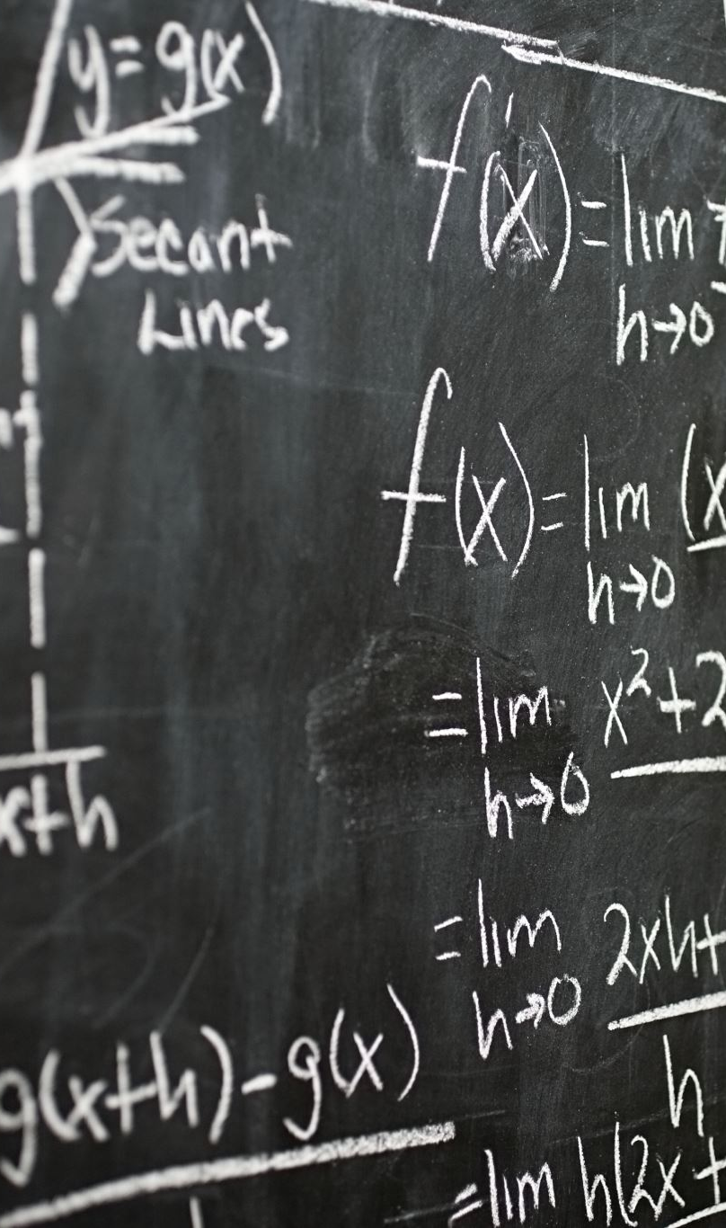
Comparison Operators with Variables
Writing “math_comparison = 4 < 5” is not very useful because we know that 4 < 5 is always true, so we should just write math_comparison = true
But comparisons are very useful when comparing variables because we may not know what the variables are
We write comparisons for variables in the same way as we do for numbers
Ex: math_comparison = first_number > second_number
Try writing a program that asks the user for 2 numbers, then prints if the first number is greater than the second number

Slide 7
Comparison Operators with the Calculator
Let’s go to our calculator program
In our calculator program, let’s print whether number_a is greater than number_b
Hint: we can convert Booleans into strings in the same way we change numbers into strings
Ex:
print("Is a > b?: " + str(number_a > number_b))

Slide 8
Comparison Operators with Strings
We can also get Boolean values by comparing words instead of numbers
When comparing words, we can only use == and !=
Ex:
words_are_the_same = “hi” == “hi” (words_are_the_same is true)
Note “Hi” == “hi” is false because the H is capitalized
words_are_different = “hi” != “bye” (words_are_different is true)
This can also be done with string variables
Ex:
words_are_the_same = word_1 == word_2

Slide 9
We could also use Booleans to improve the program we created for the warm-up
For example: If we want to program to tell the user if they will be an adult in 5 years, then we could create a variable called is_an_adult, and if the user’s age in 5 years is at least 18, the is_an_adult would equal true.
Then if is_an_adult is true, the program could tell the user
“You will be an adult in 5 years”
otherwise, the program could tell the user
“You will not be an adult in 5 years”
To do this we will need to know how to use if statements

Slide 10
If Statements
We use if statements like this:
if 3 < 5:
print(“3 < 5”)
If “hi” == “Hi”:
print(“Bye”)
Ex:
if is_raining:
print(“bring an umbrella”)
if is_cold:
print(“wear a coat”)
if is_hot:
print(“drink water”)
if is_sunny:
print(“wear sunscreen”)

Slide 11

In the example, the conditions is_raining, is_hot, is_cold, is_sunny must be Boolean variables, and if their value is true, then the program will print the corresponding line of code
Try creating this weather program:
is_raining = True
is_cold = True
is_hot = False
is_sunny = False
if is_raining:
print(“bring an umbrella”)
if is_cold:
print(“wear a coat”)
if is_hot:
print(“drink water”)
if is_sunny:
print(“wear sunscreen”)

Slide 12
If Statements with Comparison Operators
We can also use comparison operators as an if statement condition
Ex:
if 5 > 4:
print(“Five is greater than four”)
Ex:
if number_a > number_b:
print(“a is greater than b”)

Slide 13
We can use this in the weather program too
Ex:
temperature = 47
is_raining = True
is_sunny = False
if is_raining:
print(“bring an umbrella”)
if temperature < 60:
print(“wear a coat”)
if temperature > 60:
print(“drink water”)
if is_sunny:
print(“wear sunscreen”)

Slide 14

Then, if we use the input() function, we can create a useful weather program
Ex:
temperature = int(input(“What is the temperature? “))
is_raining = input(“is it raining? (y/n) “)
is_sunny = input(“is it sunny? (y/n) “)
if is_raining == “y”:
print(“bring an umbrella”)
if temperature < 60:
print(“wear a coat”)
if temperature > 60:
print(“drink water”)
if is_sunny == “y”:
print(“wear sunscreen”)

Slide 15
If Statements and Indentation
You might have noticed that whenever we create an if statement, the thing that the program does if the if statement is true is indented
This is how the program knows what is inside the if statement and what is not (similar to functions)
Using indentation, we can write multiple lines of code in a single if statement
Try it out:
if is_raining == “y”:
print(“bring an umbrella”)
print(“wear rainboots and a raincoat”)

Slide 16
Else Statements
Else statements are things that happen if the condition in the if statement is false
We write else statements like this:
if condition:
do this
else:
do this
Ex:
if temperature > 60:
print(“drink water”)
else:
print(“wear a coat”)
This can help programmers save time when writing code

Slide 17
Elif Statements
Elif statements have instructions that will happen if the condition for the if statement is false but a second condition on the elif statement is true
Ex:
if age > 62:
print(“You are a senior citizen”)
elif age >= 18:
print(“You are an adult”)
else:
print(“You are not an adult”)

Slide 18
AND and OR Operators
What if we want our if statements to test for 2 conditions instead of just one
For example, if we want to know the ticket price for a person going to the museum and the ticket price is $5 for kids or adults with a discount, we could write it 2 ways:
Way 1:
if is_a_kid:
print(“Your ticket costs $5”)
elif is_an_adult_with_discount:
print(“Your ticket costs $5”)
Way 2:
if is_a_kid or is_an_adult_with_discount:
print(“Your ticket costs $5”)

Slide 19
The and operator works in the same way as the or operator, except the or operator tests if one of the multiple conditions is true while the and operator tests if all of the conditions are true
For example:
if is_an_adult and has_discount:
is_an_adult_with_discount = True
Try out these operators
Ex:
if is_raining == “y” and is_sunny == “y”:
print(“Look for a rainbow”)

Slide 20
Project: Chose Your Own Adventure Video Game
After we put our weather program in its own function, let’s create a new function for our first video game
This video game will be a choose-your-own-adventure video game (which was the first type of video game ever created)
Let’s say the user is on a deserted island looking for treasure
We’ll start by asking if the player wants to go North, East, South, or West
Hint: we can write if statements inside of other if statements

